Slide 1


DESIGN, FABRICATION AND TESTING OF A LOCALLY REMOTELY OPERATED VEHICLE FOR HULL INSPECTION
BSc MARINE ENGINEERING
By: 1. PEGGYOLANDA NYAMBURA
2. DENNIS SAMMY
Supervisor:
Dr. ELIJAH MUNYAO

Slide 2
Content
Methodology
Results & Discussion
Time plan
Budget
Conclusion
Background of study
Problem statement
Objectives
@2024
Notes:
In the shipping industry due to safety measures, ships are required to be inspected over a given period of time.
The hull is exposed to problems such as biofouling and corrosion making its inspection vital and should be conducted regularly.

Slide 3
Background of study
Ships are required to be inspected over a given period of time as safety measures.
The hull is exposed to undesirable processes such as biofouling and corrosion making its inspection vital.
Corrosion can bring about structural failure which is a major cause of maritime accidents and ships have to undergo detailed hull inspections.
Similarly, Biofouling have a great negative impact on the performance, condition, and lifespan of the ship.
@2024
Notes:
The growth of the shipping industry increases the probability of maritime accidents, which pose a threat to human lives, economic property and marine pollution. One of the major causes of serious maritime accidents is structural failure (Dong et al., 2022) (see Fig. 1 for two examples), typically resulting from the effects of time-dependent (gradual) deterioration mechanisms, such as structural overloading, errors in ship design, the utilization of low-quality materials, inferior alignments or welding, coating breakdown and vibrations induced by hydrodynamic loads or the machinery.
To avoid (or at least reduce) the occurrences of these factors, ships are built in accordance with stringent standards of safety and pollution prevention. In addition, ships have to undergo detailed inspections during both the building and service periods (Nair et al., 2017). In this case, timely ship maintenance and repairs can be arranged based on the identified defects and faults. As a result, hull structures can be kept in a satisfactory condition and the risk of the occurrence of structural failure is reduced (Davies et al., 2021).

Slide 4
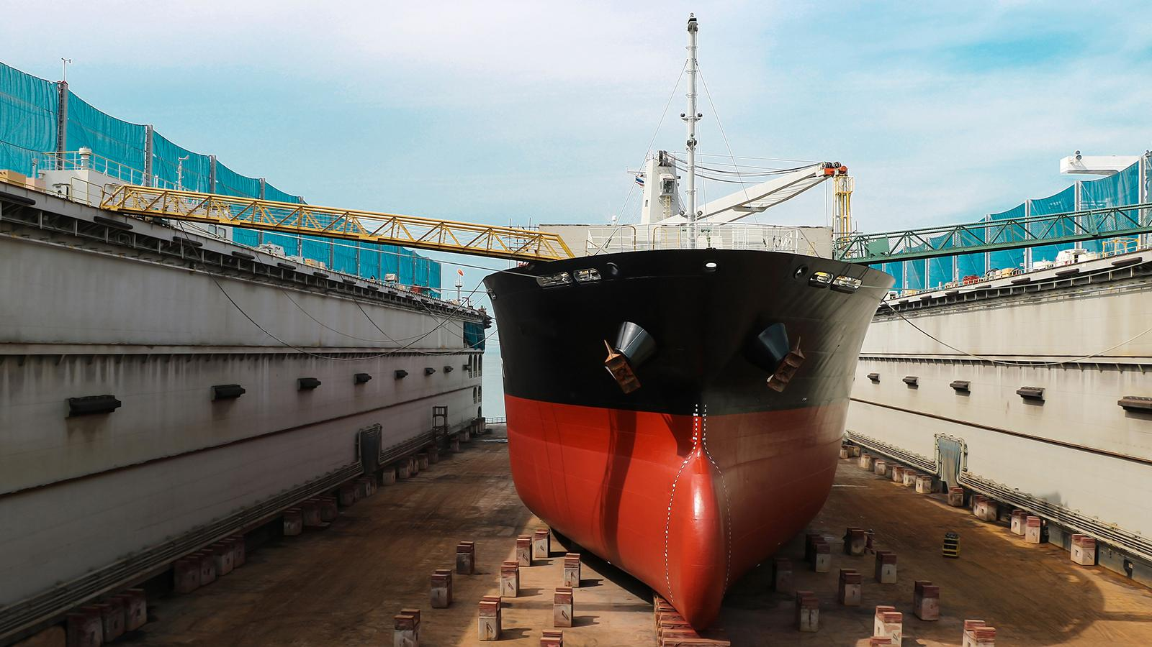
Background of study, cont.
Dry docking
Ship is unsubmerged for a comprehensive inspection to be conducted on the hull, the rudder, propeller and stabilizers
Use of underwater inspectors
Exposed to hydrostatic pressures, low visibilities, marine predators and rough and harsh sea conditions
@2024

Slide 5
Challenges faced in hull inspection
High cost
Time consuming process
Safety hazards
Limited access to some submerged areas
@2024
Notes:
In the shipping industry due to safety measures, ships are required to be inspected over a given period of time.
The hull is exposed to problems such as biofouling and corrosion making its inspection vital and should be conducted regularly.

Slide 6
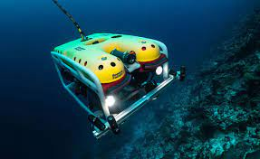
Remotely Operated Vehicle - ROV
is a maneuverable underwater machine that can be used to explore and inspect ocean depths operated by someone at the water surface.
Oil and gas companies
Marine construction works
Military and law enforcements
Underwater research
Shipping
@2024

Slide 7
Problem statement
The ROV’s high cost is a prohibitive barrier to entry into application, preventing widespread adoption of ROV for personal, research, and conservation uses.
The current work seeks to address the challenge by coming up with a low cost locally available Remotely Operated Vehicle without compromising its functionality.
@2024
Notes:
In the shipping industry due to safety measures, ships are required to be inspected over a given period of time.
The hull is exposed to problems such as biofouling and corrosion making its inspection vital and should be conducted regularly.

Slide 8
Objectives
The main objective of the current work is to design, fabricate and test a local Remotely Operated Vehicle (ROV) for hull inspection.
@2024
Notes:
In the shipping industry due to safety measures, ships are required to be inspected over a given period of time.
The hull is exposed to problems such as biofouling and corrosion making its inspection vital and should be conducted regularly.

Slide 9
Specific Objectives
Scope
To select, and analyze materials for the ROV.
To design and test the structural integrity of the ROV frame.
To design, fabricate and test the control system of a Remotely operated vehicle (ROV).
To achieve maneuverable controls on the ROV’s main axes of motion, X, Y, Z and around an obstacle underwater.
Design, Fabricate and test the control system of the ROV.
Maintain structural integrity of the frame.
Achieving maneuverable controls along the main axes of motion and around an underwater obstacle.

Slide 10
Methodology
@2024

Slide 11
Conceptual Design
Structural design.
Propulsion design.
Electronic and control design.

Slide 12
Structural design.
The main parts of the ROV structure include the frame and the electronic sealing compartment.
This design entailed selecting and analyzing materials for the key components.

Slide 13
Pros and Cons of Proposed Materials
Material | Pros | Cons
PVC | Light in weight Excellent corrosion resistance | Susceptible to UV degradation Lower strength in comparison to metals
Aluminium | Light in weight Good corrosion resistance | Requires proper anodizing
Acrylic Plexiglass | Corrosion resistant Light In weight | Expensive Complex manufacturing processes
Stainless steel | High strength and durable Good corrosion resistance | Heavy Expensive

Slide 14
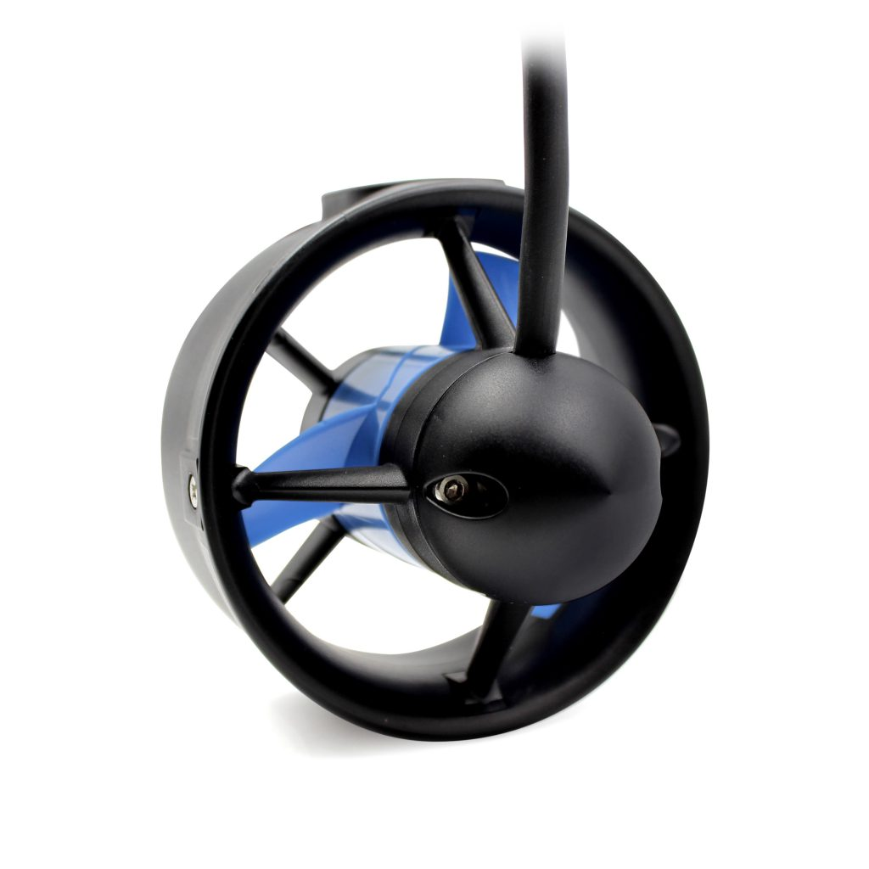
Propulsion design.
The design entailed analysis of upthrust, buoyancy, drag force, power of the motor and the thrust Force.
The configuration and placement of the thrusters.
Thruster sample

Slide 15
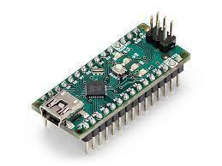
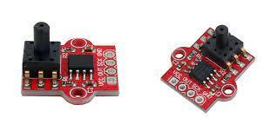
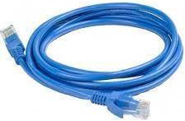
Electrical & control design.
Electrical devices
Power systems
Control and actuation system
Visual feedback
Arduino nano
Pressure sensors
Ethernet cable

Slide 16
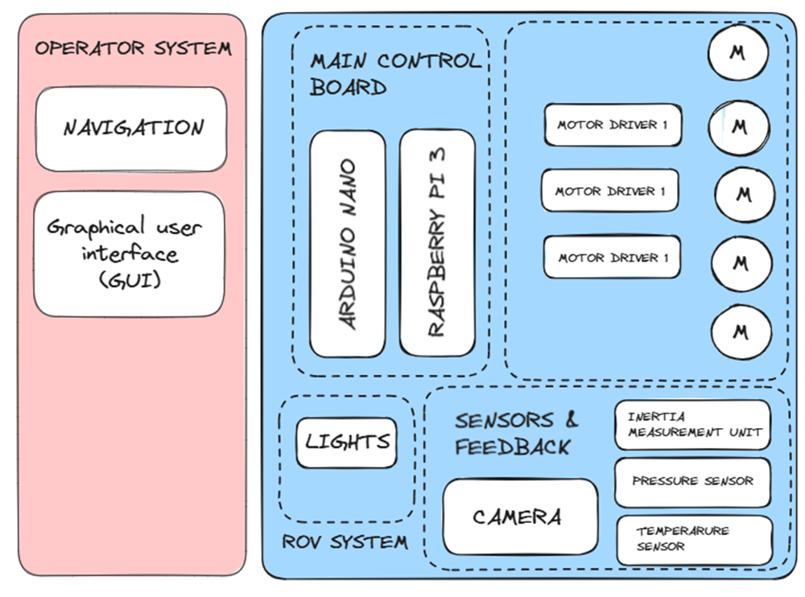
Electronic Architecture

Slide 17
2. Fabrication and Assembly
Implementing the ROV design will follow a series of processes where it will involve the acquiring of materials, parts, electrical components and integration of the software and hardware, as well as assembly of the ROV.

Slide 18
3. Testing
The ROV is tested to ensure:
The functionality of the designed control system of the ROV
Ability to achieve maneuverability in the main axes of motion and around an obstacle.

Slide 19
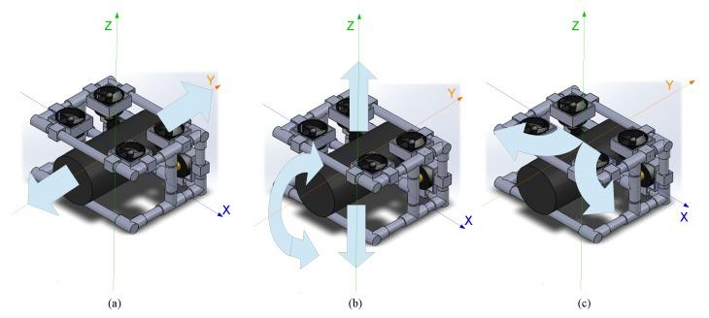
Figure 1: showing Movements of the ROV: (a) lateral; (b) ascent and descent; and (c) rotation.

Slide 20
Results & Discussion
@2024

Slide 21
Material selected should withstand the pressure experienced at the draught of the vessel.
Settling on an average depth of 10m - greater than the draughts of many smaller vessels such as Aylah 1.
@2024

Slide 22
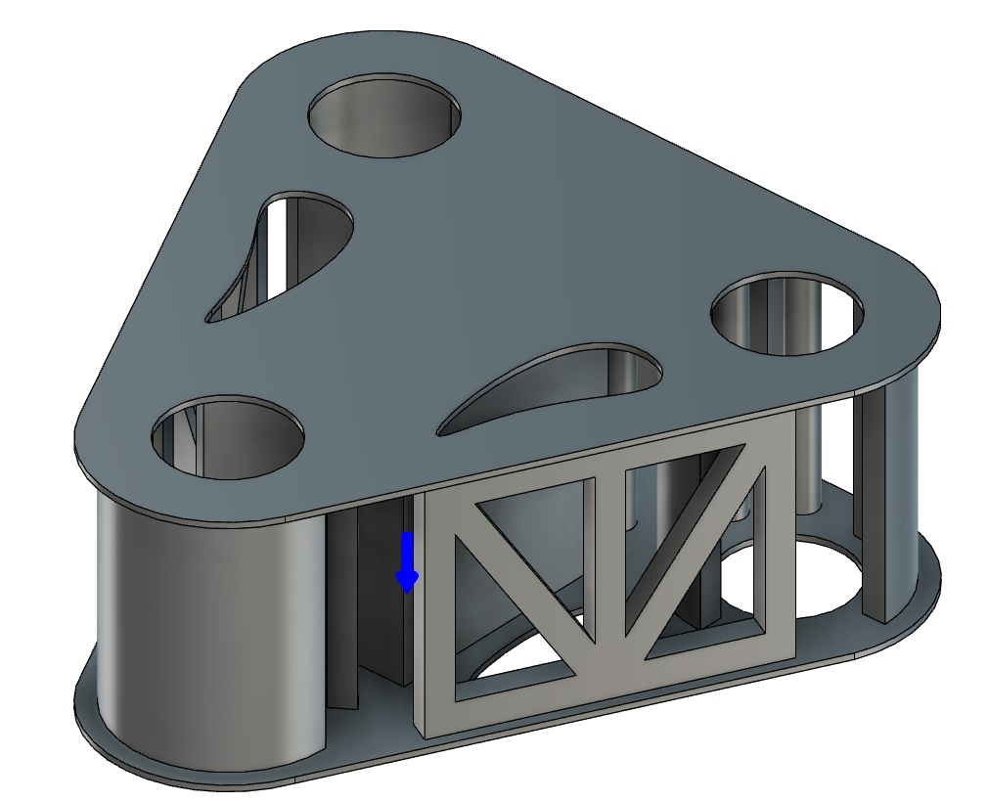
Principal Dimensions
Length | 550 mm
Width | 550 mm
Height | 211.13 mm
Thickness | 5 mm
@2024

Slide 23
The frame is subjected to a stress and deformation analysis through a series of pressures for different depths.
No | Depth | Load (Pa)
1 | 10 | 101,043
2 | 50 | 505,215
3 | 100 | 1,010,430

Slide 24
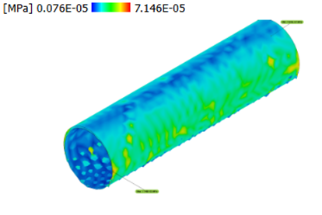
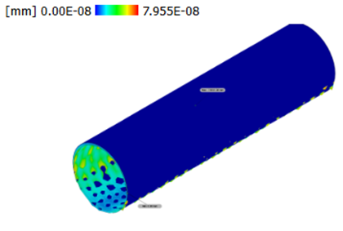
The sealing compartment is also subjected to a stress and deformation analysis.
No | Depth(m) | Deformation(mm) | Stress (Mpa)
1 | 100 | 7.955E-08 | 7.146E-05
@2024

Slide 25
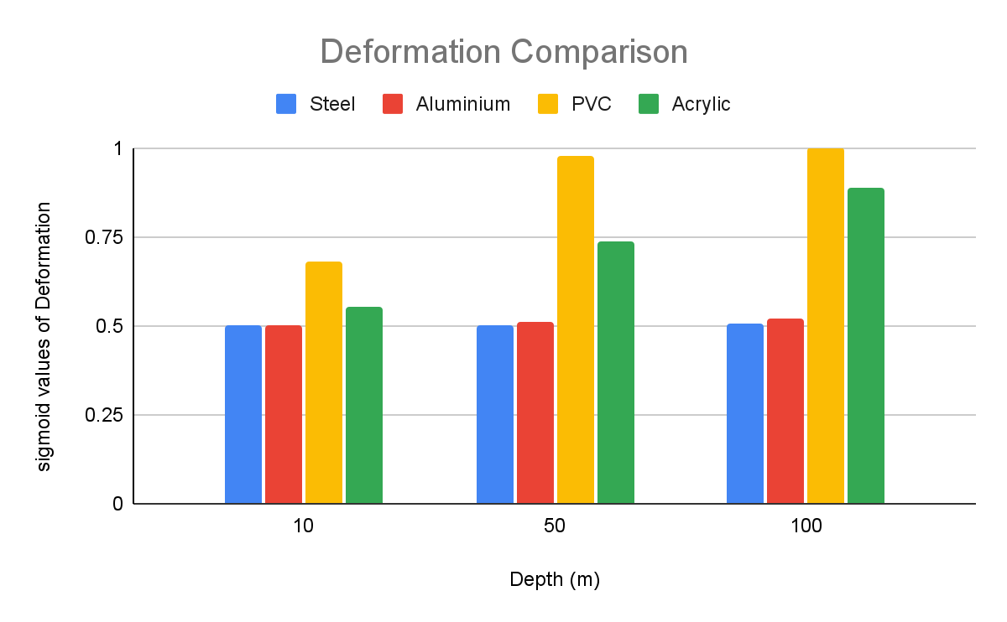
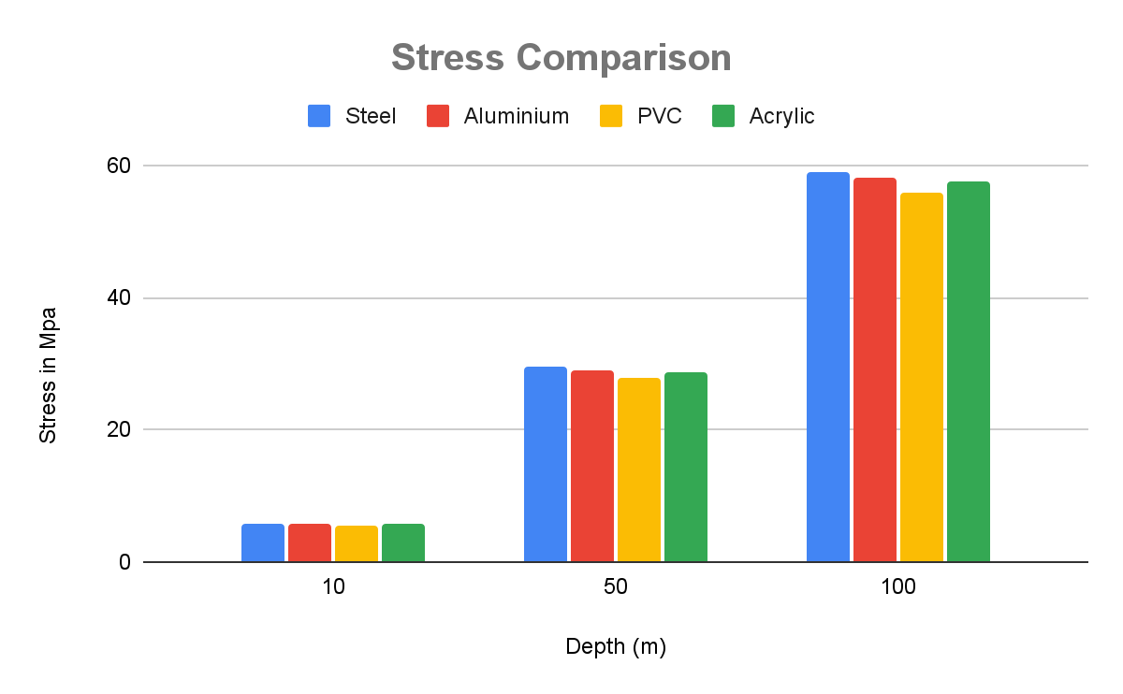
Stress and Deformation analysis of the frame on Depth Variation
@2024

Slide 26
Determination of weight and displacement.
The mass of the ROV is 18.67425kg
The weight of the ROV is 183.1943925N
The displacement volume of the ROV is 1.127*10^7 mm^3
@2024

Slide 27
Calculation of upthrust, Buoyancy, Drag Force, and Thrust Force
Buoyancy = 8.8e-7N
Force of drag = 14.02N
Power required = 16.08W
Thrust required = 14.02N
@2024

Slide 28
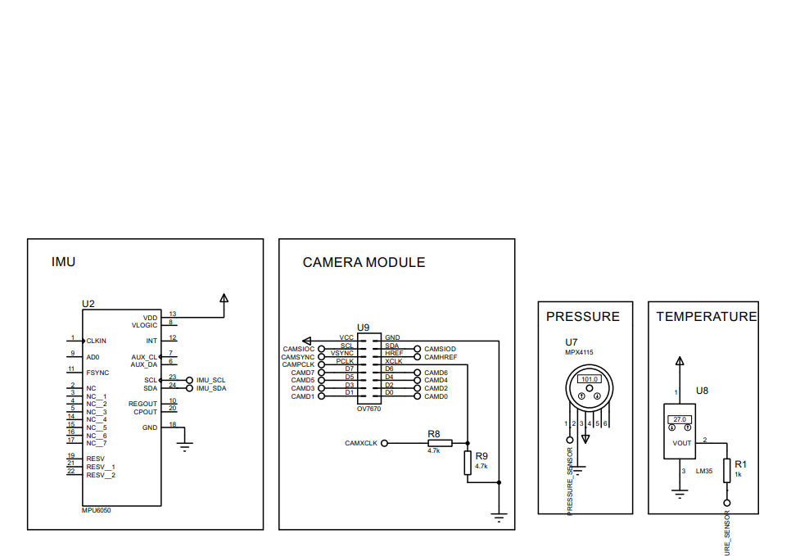
Electrical and electronic architecture design.
@2024

Slide 29
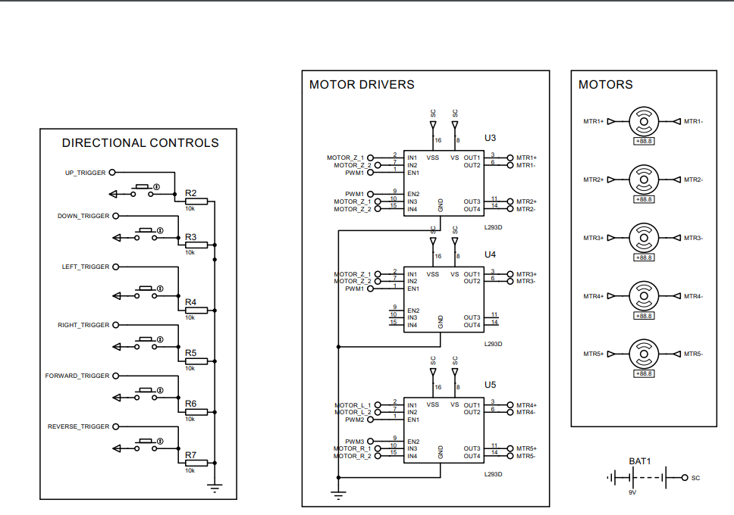
Electrical and electronic architecture design.
@2024

Slide 30
Conclusion
The use of ROVs for underwater inspection exercises is a potential solution to challenges of hull inspection. This report proposes specific objectives which include the design, fabrication and testing of a control system of an underwater ROV.
@2024

Slide 31

Time plan

Slide 32
 | May | June | July | August | September | October | November | December
Literature Review
Main structural design
Electronic design
Raspberry implementation
Assembly
Testing
Final Presentation

Slide 33

Estimated budget
Power supply | KES 1560
Electronics | KES 3180
Propulsion system | KES 6000
Total | KES 10,740

Slide 34

Remotely Operated Vehicles
Presented by:
PEGGYOLANDA NYAMBURA
DENNIS SAMMY
@2023
Notes:
Introduction

Slide 35
